Slide 1


Bayesian Inference for Portfolio Optimization using Stan
Ankita
Bindu
Duo
Nikita

Slide 2
What is stan?
Stan is a C++ library for Bayesian inference.
Stan is a state-of-the-art platform for statistical modeling and high-performance statistical computation.
Designed specifically for defining and fitting statistical models.
Based on the No-U-Turn sampler (NUTS), which is used for estimating the posterior distribution.
Stan must be called from another language such as R, Julia, or Python.

Slide 3
Why stan?
An open-source software that provides an intuitive language for statistical modeling.
Provides fast and stable algorithms for fully Bayesian inference.
The Stan language is compatible with various editors for syntax highlighting, formatting, and checking (for instance, Rstudio).
Stan is interfaced with numerous softwares, including RStan (R), PyStan (Python), ScalaStan (Scala) etc.

Slide 4
Installation
Install R for Windows from the following link
https://cran.r-project.org/bin/windows/base/
Install RTools for Windows from the following link
https://cran.r-project.org/bin/windows/Rtools/
Install RStudio for Windows from the following link
https://posit.co/download/rstudio-desktop/
Install RStudioapi using the R statement below
install.packages("rstudioapi")
Load RStudioapi using the following statement
library(rstudioapi)

Slide 5
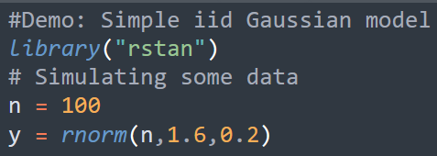
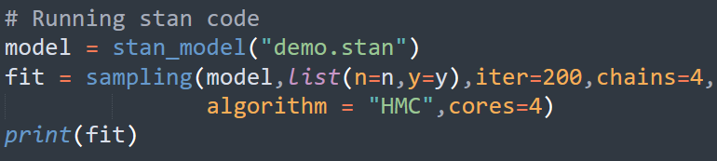
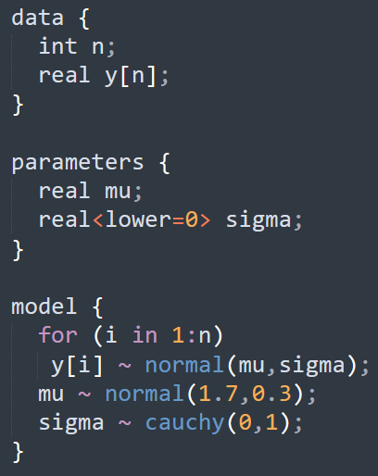
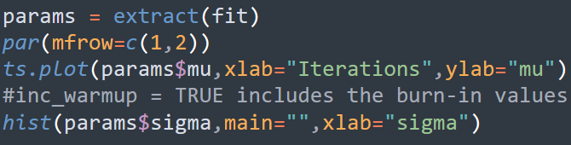
Simple i.i.d. Gaussian Model
Step 1 - Prepare the data in R
Step 2 - Define a statistical model in Stan
Step 3 - Fit the model in Stan
Step 4 - Perform inference using simulated posterior draws

Slide 6
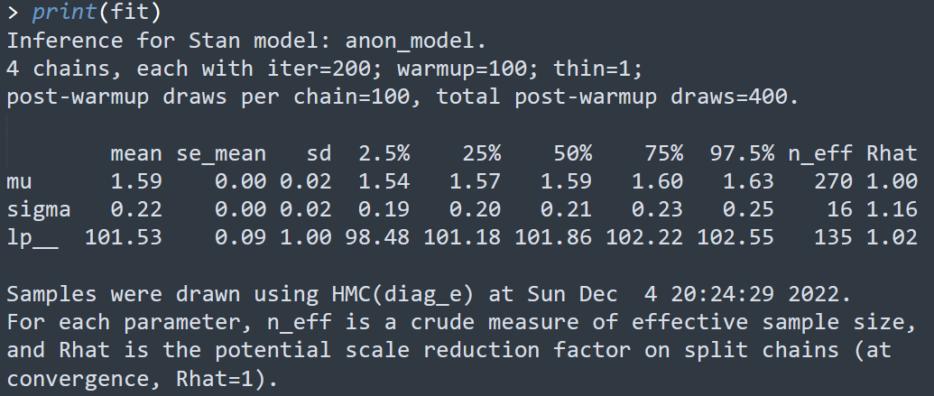
Results of Demo example

Slide 7
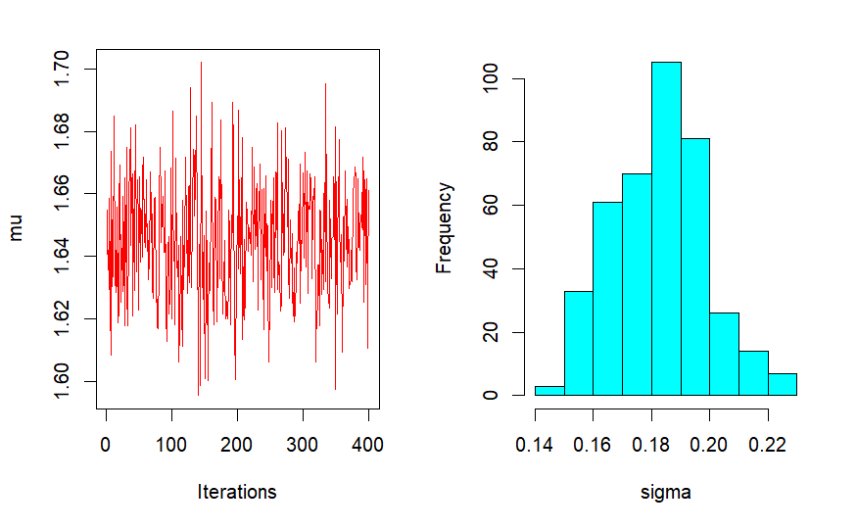
Diagnostics in R

Slide 8



Key Terms
Portfolio: Set of assets each having weight
Goal: Find optimal vector W
How to achieve goal? Minimizing the portfolio’s returns variance and parallely achieving the target level of return (or expected return or efficient frontier).
What are returns? Gain or loss realized by investment (or price of an asset). Thinking of these in terms of log.
Distribution of returns:
Expected Return:
Portfolio’s variance:

Slide 9



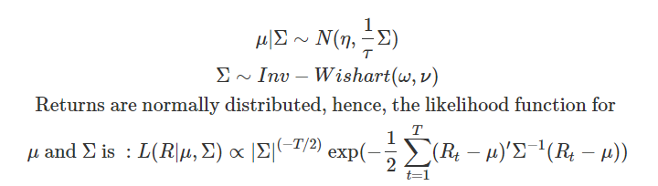
Portfolio’s Optimization Problem
Sample Estimates:
Classical Formulation:
Bayesian Framework: Mean and variance-covariance are desired stochastic quantities. Let’s assume,

Slide 10
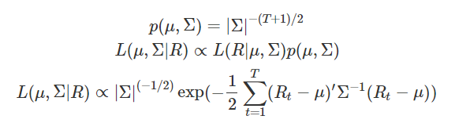
Posterior Distribution for optimization
Joint distribution and posterior distribution for achieving the goal of getting minimum variance for the target expected return can be represented as follows:
References:
Kandel, S., McCulloch, R., & Stambaugh, R. F. (1995). Bayesian inference and portfolio efficiency. The Review of Financial Studies, 8(1), 1-53.
Bodnar, T., Lindholm, M., Niklasson, V., & Thorsén, E. (2022). Bayesian portfolio selection using VaR and CVaR. Applied Mathematics and Computation, 427, 127120.

Slide 11
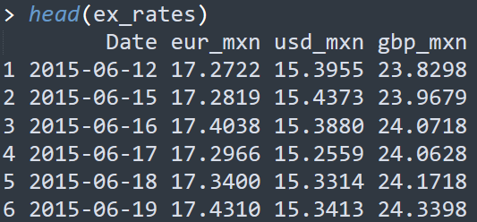
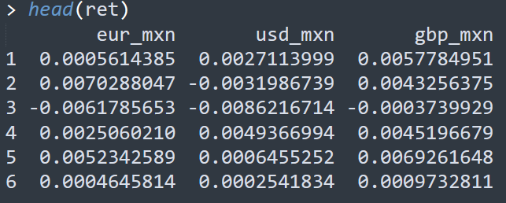
Time Series Data
Shape: (1283, 4)
Three exchange rates of US, Euro, and Pound Sterling to Mexican Peso.
The displayed rates are adjusted by taking log.
Time duration: 2015-16-12 to 2020-06-12

Slide 12
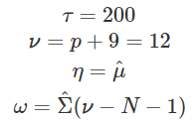
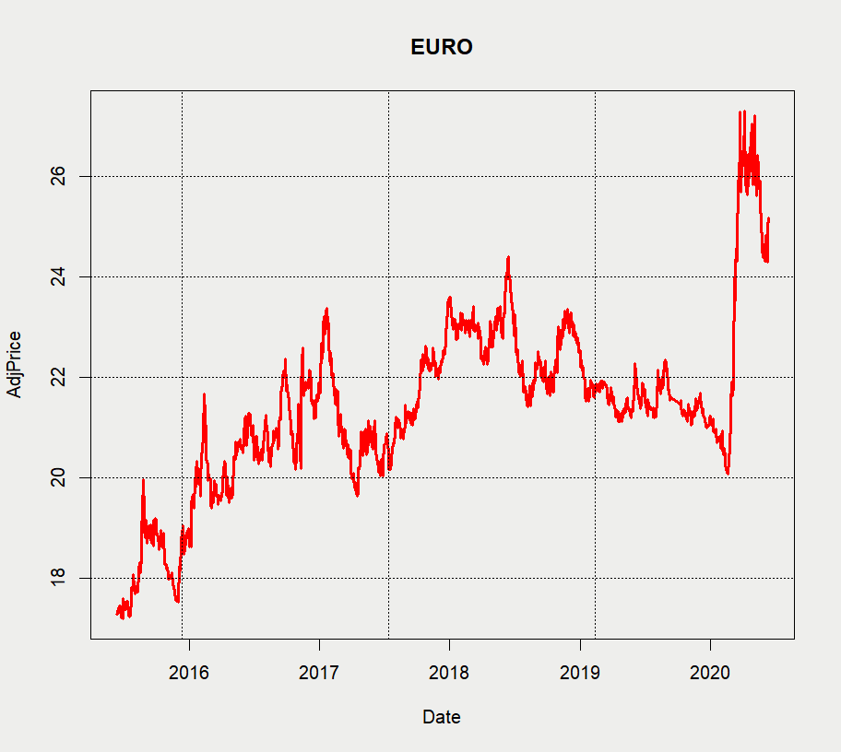
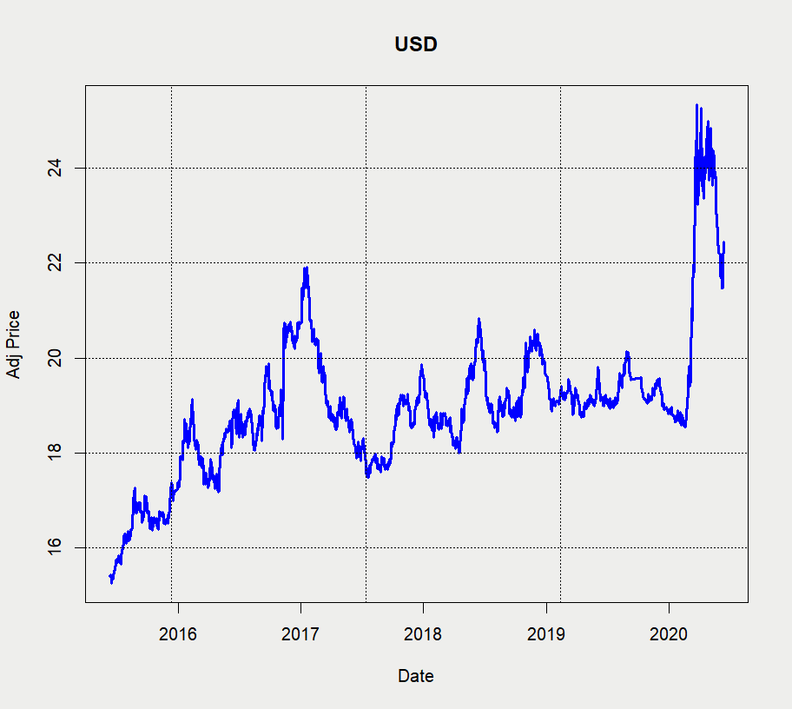
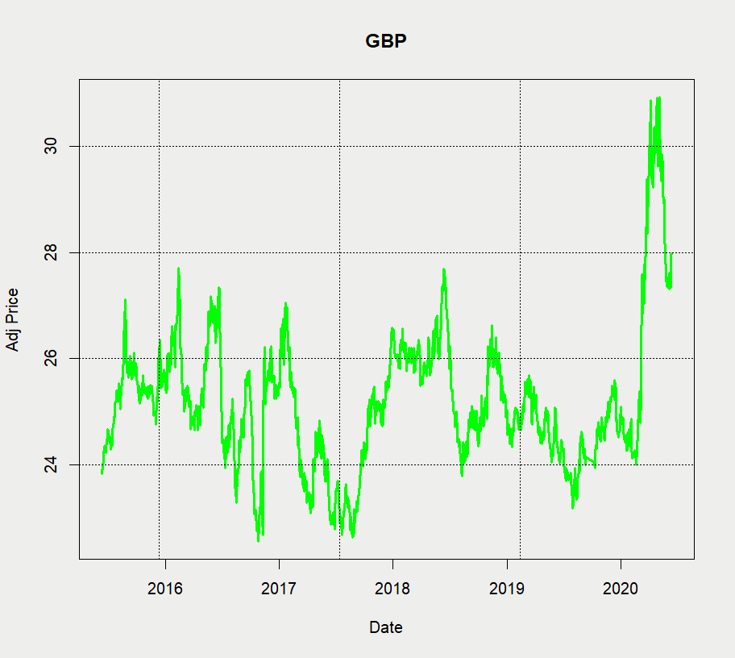
Implementation
Hyperparameter choice:
Unit Information Prior

Slide 13
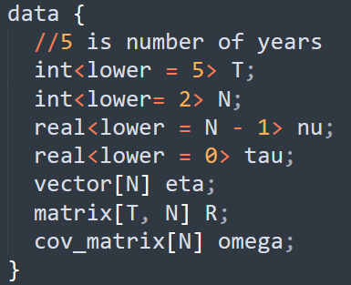
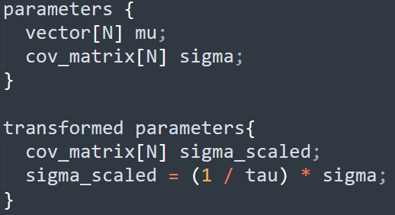
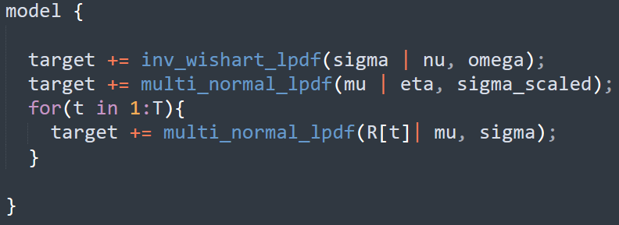
Stan blocks (in bay_opt.stan file)
Parameter
& Transformed Parameter Block
Data Block
Model Block

Slide 14
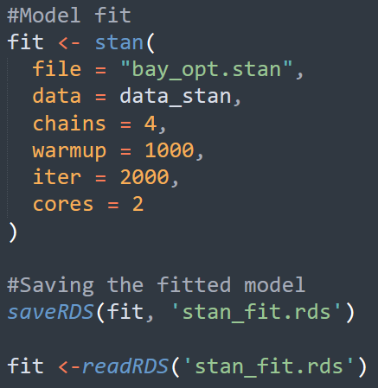
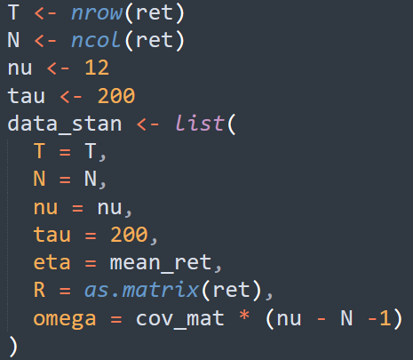
Model Fit in R

Slide 15
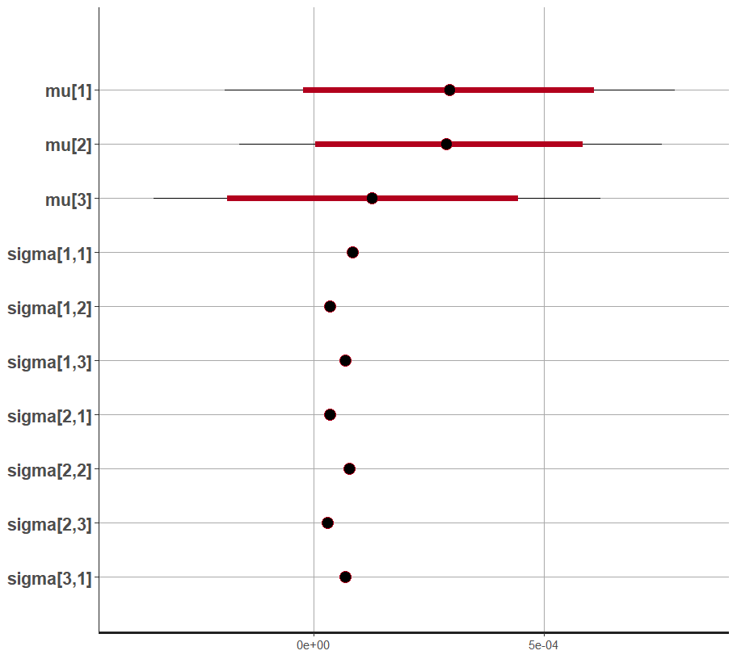
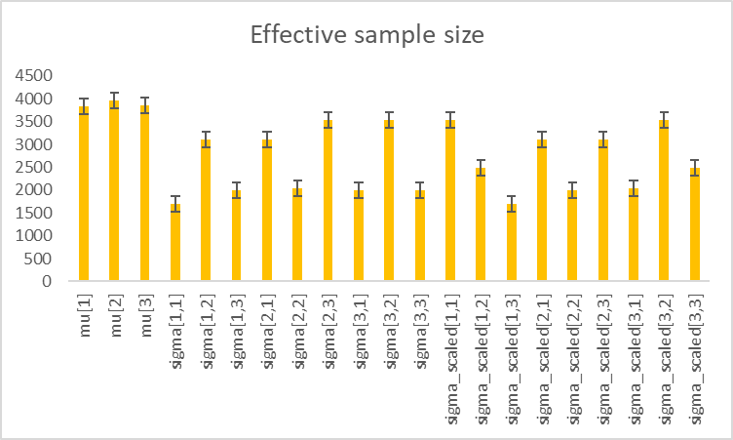
Diagnostics in R

Slide 16
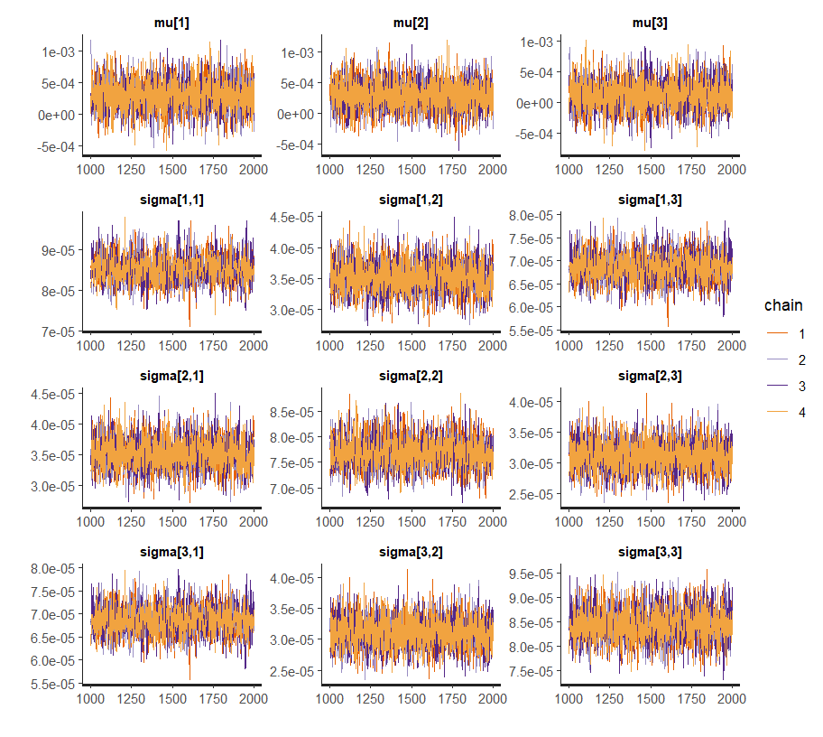
Convergence of Markov Chain

Slide 17
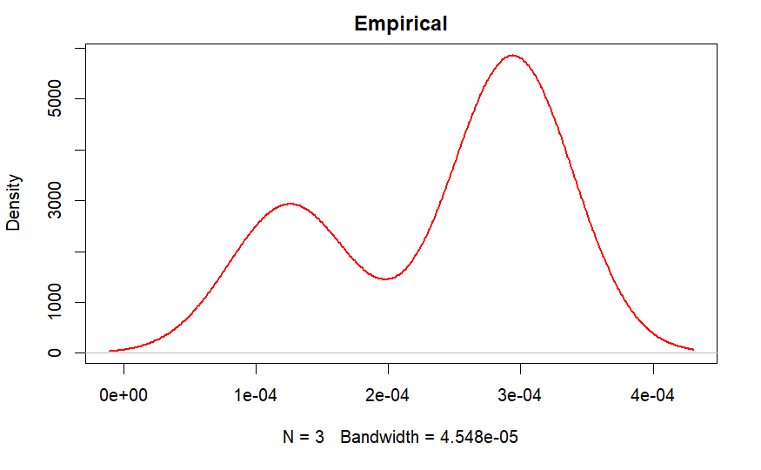
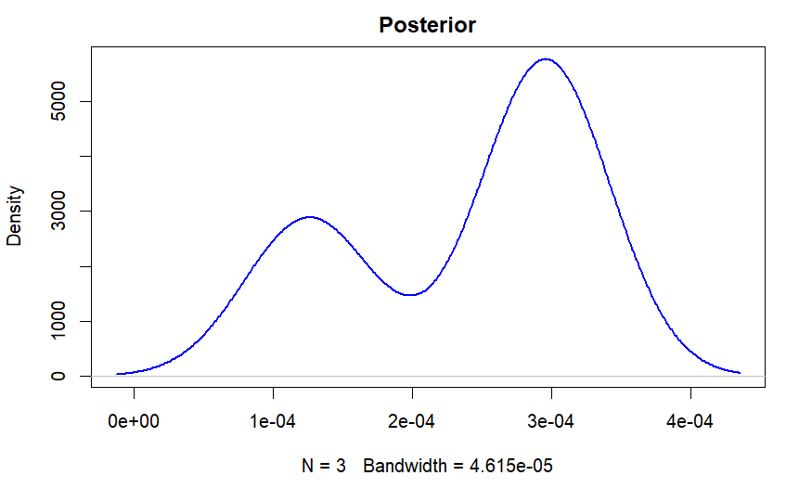
Preliminary check for posterior
mean
samples

Slide 18
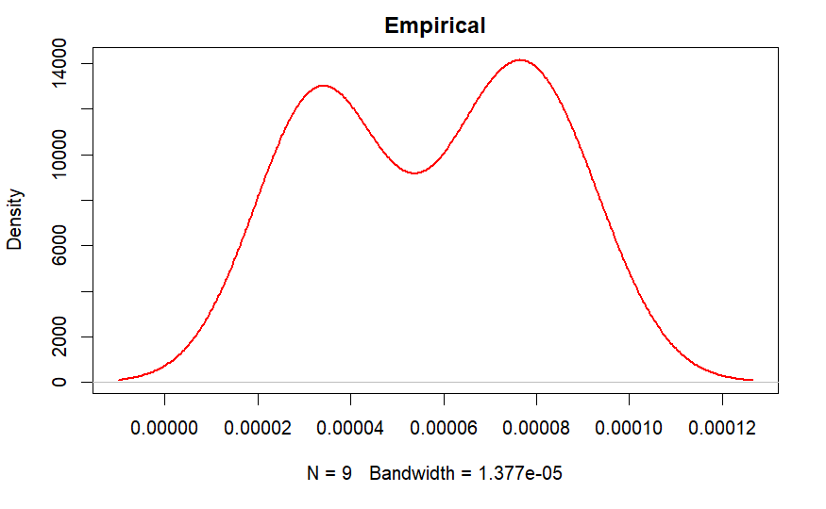
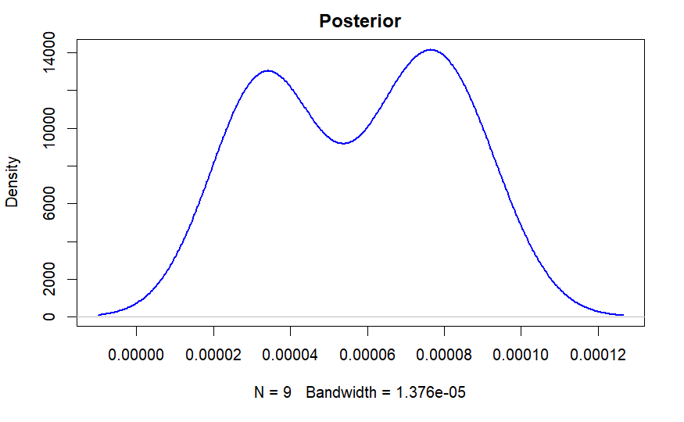
Preliminary check for posterior variance- covariance samples

Slide 19
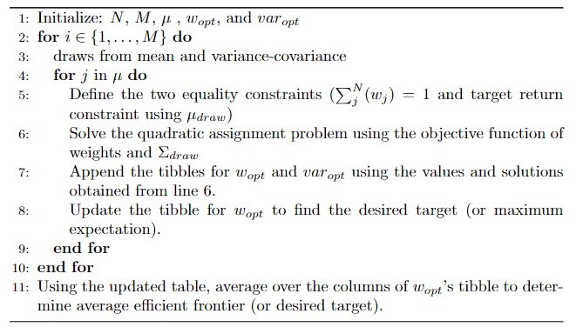
Bayesian Optimization Algorithm

Slide 20
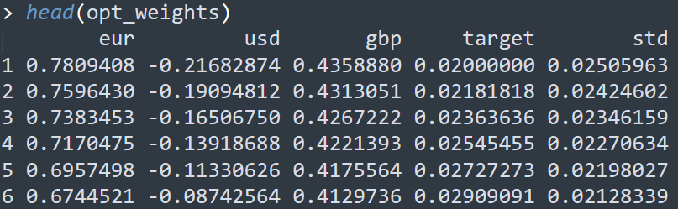
Results of optimal weights
These are the optimal weights of each asset i, class for all the columns.

Slide 21
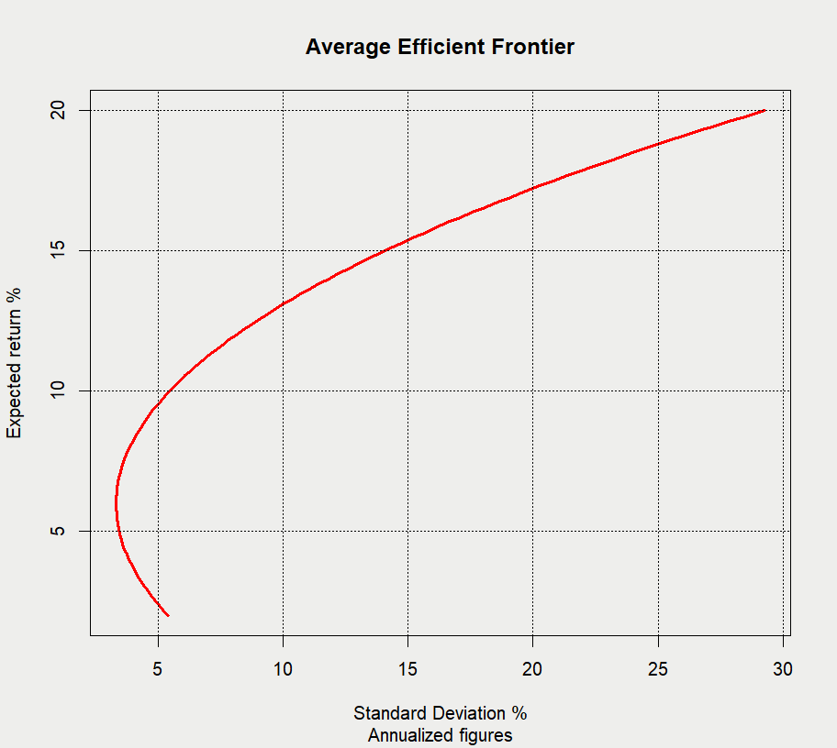
Expected return vs Portfolio’s variance
Minimum
Variance

Slide 22
Conclusion and Future Work
By incorporating uncertainty in our estimates for mean and variance, we were able to construct efficient frontier within the Bayesian framework.
We can make better decisions by incorporating these uncertainties into our decision-making process.
In this use-case, assumption was log-returns are normally distributed, in future, more realistic distributions can be incorporated.
Comparison of our estimates using different priors is one of the future goals (can be extended as a project).

